Slide 1

Introducing Kanban
Balancing Work In Process And Capacity

Slide 2

Notes:
More work than time

Slide 3

Notes:
Massive batch and queue size with waterfall
Learned that lesson and Agile Manifesto was born

Slide 4

Notes:
Large batches of work build up over time and across each phase

Slide 5
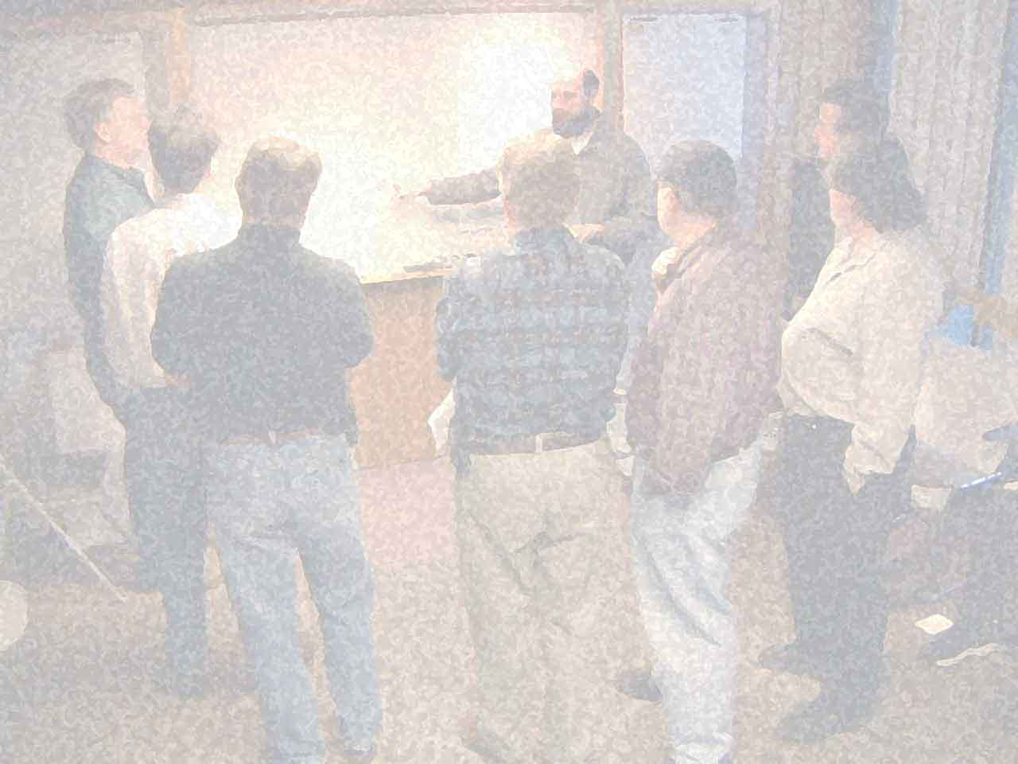
We are uncovering better ways of developing software by doing it and helping others do it.
Notes:
Agile Manifesto got it right

Slide 6

Notes:
Iterative != timebox
not everything fits into a 2 week iteration or 1 month sprint
Rhythm and cadence can be complex when dealing with multiple aspects of the process

Slide 7

Notes:
needs change without regard to time boxes
With even a small change, schedules are thrown out the window and we scramble to catch up
We (industry) seem to be stuck in reactionary mode instead of proactive approach

Slide 8

Lean Thinking
Notes:
Eliminate waste
Systems thinking
Continuous improvement

Slide 9
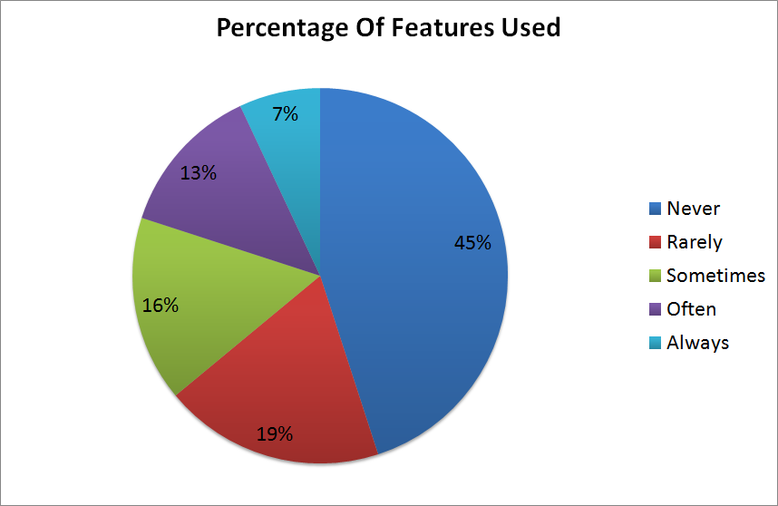
Source: Standish Group CHAOS Study
Notes:
Massive waste in overproduction of features

Slide 10

Notes:
Whole value stream
flow of value through entire process, not just development effort
Scrum and XP tend to focus on the development team only

Slide 11
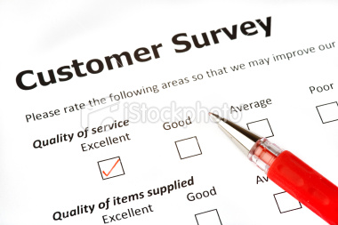
Notes:
Defect prevention
Reduce lead time
Increase quality

Slide 12

Lean Tools
Notes:
Drawn from many other process improvement programs and sources

Slide 13

start
finish
Notes:
Value stream mapping
Showing all of the steps that it takes to get from input to delivered value

Slide 14

Notes:
Production leveling: Large work items take too long
Reduced feedback. Increased lead time.
Reducing variance in work items to balance flow of value and increase feedback

Slide 15

Notes:
Andon – stop the line when an error is found.
Jidoka – autonomation. Automation with a human touch. Stop and fix it now. CI and broken builds. Big flashing lights, etc.

Slide 16

Notes:
Root cause analysis: 5 why’s
Not who, but why
Poka-Yoke - Mistake proofing: put in measures to prevent the problem in the future

Slide 17

Notes:
PDCA: plan do check act
Process improvement
Kaizen: Continuous improvement
Like peeling an onion that never ends

Slide 18

Pull Systems: Kanban
Notes:
Pull systems – authorizing work based on capacity, not schedule

Slide 19

Notes:
Origin of pull systems: grocery store shelves
Customer pulls value, causes work all the way back up the value stream

Slide 20
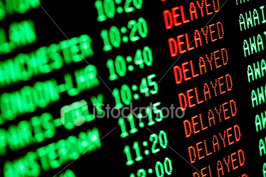
Notes:
Working to schedule in non-predictable, non-linear system will cause delays
“failed” iterations / sprints caused by delay and overbooking work

Slide 21

Notes:
Recognize the capacity of the system and the individual resources
Authorizing work by available capacity, not schedule
Balancing capacity and demand

Slide 22

Notes:
Queues: protecting against bottleneck and starvation
Facilitating hand off between resources / steps in process
Managed inventory
Step + Queue = WIP Limit

Slide 23

Notes:
Kanban: signal to do work

Slide 24

Notes:
Rhythm & flow. Synchronizing the various aspects of a software development system and teams
Time boxed iterations/sprints couple various synchronization points, artificially
Decouple the rhythms of: planning work, start and stop of work, demoing value, delivering value, retrospectives and improving, etc

Slide 25

Getting Started

Slide 26
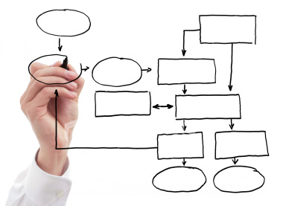
Notes:
Visualize your process – your value stream
It’s your process, kanban won’t force any given steps on you
Kanban is process control, not how-to process work to add value

Slide 27
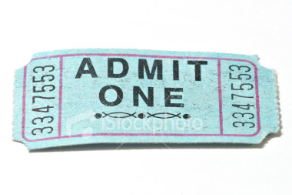
Notes:
Limit work in process
Recognize the inherent capacity of the system and the team, to get things done
Set work in process limits for the various steps in the system
Identify queues – handoffs between resources and steps

Slide 28

Notes:
Pull, don’t push
Read the kanban board from right to left
Pull work into process when capacity is available (when Kanban signal is received)
(run kanban simulation here)

Slide 29

Monitor & Improve
Notes:
Monitor and improve: Kanban as a change management system

Slide 30

Notes:
The mechanics of kanban are necessary but not sufficient
Focusing on the kanban signal itself, or the simple mechanics of pull and limited WIP will miss out on a lot of opportunity for improvement
Kanban is a thinking system – there is no prescriptive way to implement it. You must think for your team and circumstances

Slide 31
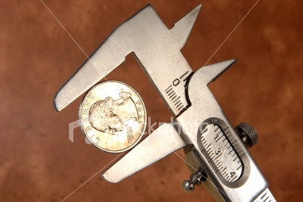
Notes:
Cycle Time: the time it takes to get work item through a process. Macro and Micro view of cycle time
Lead Time: time it takes from request for feature or functionality, to delivery of feature or functionality
Production Rate: how often a task is completed
Process Cycle Efficiency: Cycle Time (System Level) / Lead Time
These are trailing indicators

Slide 32

Notes:
Focus on lead time, not production rate
Reducing lead time leads to capability to increase production rate
Can reduce lead time by increasing speed of cars – no additional infrastructure needed, just need people to drive faster
Focusing on production rate will not reduce lead time, may cost more – have to build more capacity – more lanes on the highway

Slide 33
Step 1
Step 2
Step 3
Step 4
3
2
5
3
Input
Output
Done
Done
Done
Notes:
Total WIP in system and current WIP in each step are leading indicators
Remember: Step + Queue = WIP limit
Identify the problems that are already occurring in this system

Slide 34
Feature Request
User Story / MMF / Use Case
Work Items (Tasks)
Notes:
Production leveling in software engineering: breakdown and rollup of work
Iterative and incremental
Facilitates rapid feedback at work item level
Measure and monitor at all levels of breakdown / roll up – multi-tiered kanban boards

Slide 35
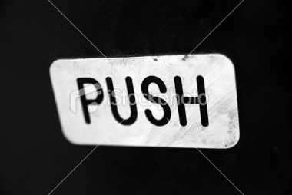
Notes:
Push is not inherently evil
Every pull system needs a little push
Customer pushes requirements onto us
Scheduling work breakdown and work item design: pushing work items into backlog, ready to go

Slide 36

Notes:
Time for Q&A

Slide 37
Additional Resources
Limited WIP Society: resources for kanban & pull systems http://www.limitedwipsociety.org
KanbanDev: user group / mailing list http://finance.groups.yahoo.com/group/kanbandev/
David Anderson: Kanban in software development industry leader http://agilemanagement.net
Tom & Mary Poppendieck: lean software development experts http://www.poppendieck.com/

Slide 38
About Me
Contact Me: Twitter: @derickbailey Email: derick@derickbailey.com
Blogging With LosTechies: http://derickbailey.lostechies.com
Current Employer: McLane Advanced Technologies http://mclaneat.com
About Me: Sr. Architect, Software Engineer, Lean / Agile Coach 12+ years professional software development experience 20+ years writing code

